Slide 1
Cluster Analysis (K-Means Algorithm)
By
Adnan Amin
Lecturer, IMSciences Peshawar
adnan.amin@imsciences.edu.pk

Slide 2
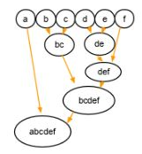
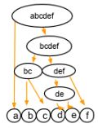

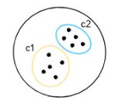
Types of Clustering
Hierarchical clustering
Agglomerative clustering (bottom-up approach)
Divisive clustering (top-down approach)
Partitioning clustering
K-means,
k-mediod,
Fuzzy C-means

Slide 3
Introduction to K-Means
Type of unsupervised learning (used when you have unlabeled data)
Unlabeled data:
Data without defined categories or groups
K-Means algorithm is used to find groups in the data.
The number of groups represented by K.
Data samples are grouped based on feature similarity.
Distance based
K-means is partitioning clustering algorithm
Alternative names:
Centriod-based algorithm
Distance-based algorithm

Slide 4
Real-world examples
Behavioral segmentation
Segment by purchase history, activities on web
Inventory categorization
Group sales activity
Group manufacturing metrics
Outlier detection
Separate valid and invalid groups
Detect activities types in motion sensors
Group similar/dissimilar images

Slide 5
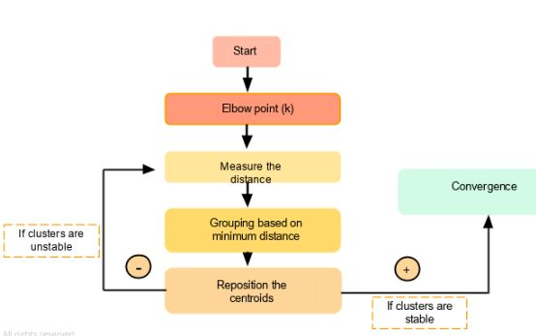
K-Means clustering flowchart
https://www.simplilearn.com/tutorials/machine-learning-tutorial/k-means-clustering-algorithm

Slide 6
K-Means Clustering
Use the k-means algorithm and Euclidean distance to cluster the following 8 examples into 3 clusters:
A1=(2,10),
A2=(2,5),
A3=(8,4),
A4=(5,8),
A5=(7,5),
A6=(6,4),
A7=(1,2),
A8=(4,9)

Slide 7
The distance matrix based on the Euclidean distance:
d(a,b) denotes the Eucledian distance between a and b. It is obtained directly from the distance matrix or calculated as follows:

Slide 8
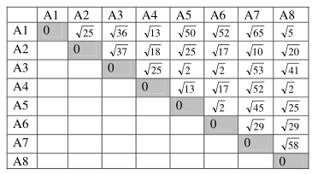
A1=(2,10), A2=(2,5), A3=(8,4), A4=(5,8), A5=(7,5), A6=(6,4), A7=(1,2), A8=(4,9)

Slide 9
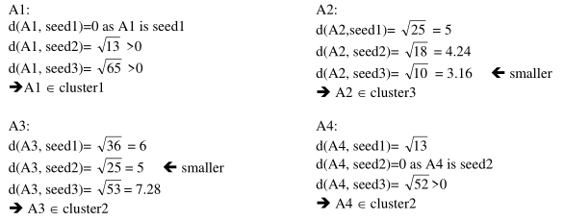
Start

Slide 10
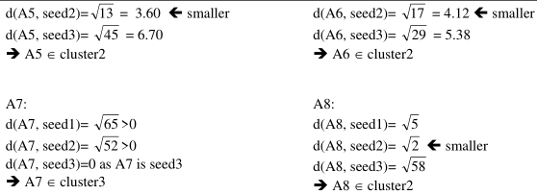
new clusters: 1: {A1}, 2: {A3, A4, A5, A6, A8}, 3: {A2, A7}

Slide 11
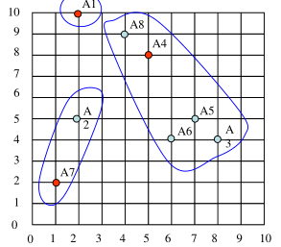
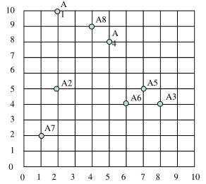
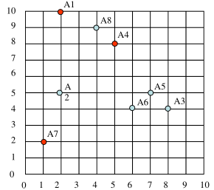
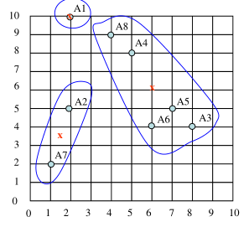
From previous new clusters:
1: {A1}, 2: {A3, A4, A5, A6, A8}, 3: {A2, A7}
centers of the new clusters
C1= (2, 10),
C2= ((8+5+7+6+4)/5, (4+8+5+4+9)/5) = (6, 6),
C3= ((2+1)/2, (5+2)/2) = (1.5, 3.5)

Slide 12
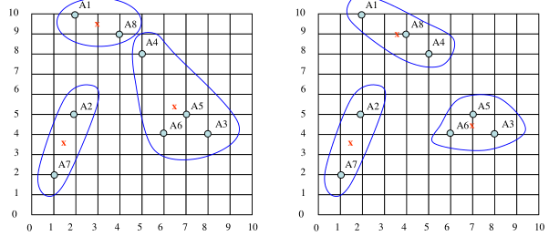
We would need two more epochs. After the 2nd epoch the results would be:
1: {A1, A8}, 2: {A3, A4, A5, A6}, 3: {A2, A7}
with centers C1=(3, 9.5), C2=(6.5, 5.25) and C3=(1.5, 3.5).
After the 3rd epoch, the results would be:
1: {A1, A4, A8}, 2: {A3, A5, A6}, 3: {A2, A7}
with centers C1=(3.66, 9), C2=(7, 4.33) and C3=(1.5, 3.5).4

